Slide 1
IoT Prototype with Nucleo-G071RB
ESS Project Presentation Introduction
Summer Semester 2025

Slide 2
Project Introduction
In this project, we implement a Nucleo-G071RB-based IoT prototype capable of:
- Collecting pressure, temperature, and humidity data using the BME680 sensor over I2C.
- Communicating via the SX1262 LoRa HAT over SPI.
- Receiving and executing UART commands from a PC terminal.
The goal is to develop a functional, testable IoT system prototype demonstrating efficient embedded system implementation.

Slide 3
Model and Components Overview
Key Components:
- Nucleo-G071RB: Microcontroller board managing communication and sensor readings.
- BME680: Sensor for temperature, humidity, and pressure (via I2C).
- SX1262 LoRa HAT: LoRa communication module (via SPI).
- USB-UART Adapter: PC communication for command execution.
The system will collect environmental data and respond to commands in a modular, testable structure.

Slide 4
Components Connection
The system connections are as follows:
- Nucleo-G071RB ↔ BME680: I2C communication (SCL, SDA).
- Nucleo-G071RB ↔ SX1262 LoRa HAT: SPI communication (MOSI, MISO, SCK, NSS).
- Nucleo-G071RB ↔ PC: UART communication via USB-UART adapter.
A clear block diagram will illustrate the component interactions during the demonstration.

Slide 5
System & Software Architecture
Our architecture ensures clear modularity:
- **System Level:** Nucleo board manages sensor data collection and LoRa communication.
- **Software Level:** Structured to handle UART commands, execute operations, and interact with peripherals.
- Follows clear layers for hardware abstraction, data processing, and command handling.
Traceability links requirements to implementation for testability and maintainability.

Slide 6
Requirements Traceability
Traceability ensures each requirement is mapped to implementation:
- **System Requirements → Architecture Blocks**
- **Software Requirements → Modules/Functions**
- **Hardware Requirements → Connections & Interfaces**
This traceability allows clear testing, validation, and systematic debugging during implementation.

Slide 7
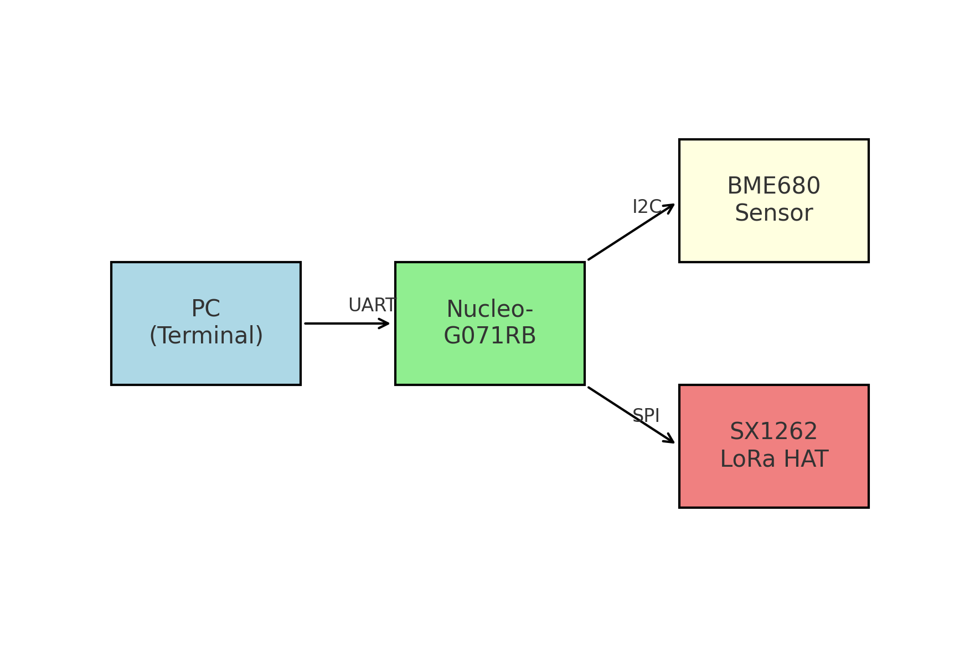
Components Connection Diagram

